Slide 1



The Bees Algorithm, and Its Applications
Dr. Ziad Salem, HDD, PhD, BsC.
Spezs1@hotmail.com
Computer Engineering Department
Electrical and Electronic Engineering Faculty
Aleppo University, Aleppo, Syrian Arab Republic
Masaryk University, Brno, Czech Republic , Wed 08 Apr 2009

Slide 2
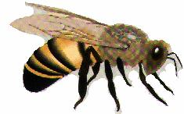
Outlines
Introduction
Intelligent Swarm –based optimisation
The Bees Algorithm
Bees in Nature
Proposed Bees Algorithm
Simple Example
BA Applications
Applications to Data mining
Conclusion
Masaryk University, Brno, Czech Republic , Wed 08 Apr 2009

Slide 3
Introduction
There was a great interest between researchers to generate search algorithms that find near-optimal solutions in reasonable running time
The Swarm-based Algorithm is a search algorithm capable of locating good solutions efficiently
The algorithm could be considered as belonging to the category of “Intelligent Optimisation Tools”
Masaryk University, Brno, Czech Republic , Wed 08 Apr 2009

Slide 4
Swarm-based Optimisation Algorithm
SOAs mince nature’s methods to derive a search towards the optimal solution
The key difference between SOAs and direct search algorithms such as Hill Climbing is that SOAs use a population of solutions for every iteration instead of a single solution
As a population of solutions is processed in an iteration, the outcome of each iteration is also a population of solutions
Masaryk University, Brno, Czech Republic , Wed 08 Apr 2009

Slide 5
Hill Climbing
Is a mathematical optimization technique which belongs to the family of local search
It can be used to solve problems that have many solutions, some of which are better than others
  It starts with a random (potentially poor) solution, and iteratively makes small changes to the solution, each time improving it a little. When the algorithm cannot see any improvement anymore, it terminates. Ideally, at that point the current solution is close to optimal, but it is not guaranteed that hill climbing will ever come close to the optimal solution
Masaryk University, Brno, Czech Republic , Wed 08 Apr 2009

Slide 6
Hill Climbing
It can be applied to the traveling Salesman Problem. It is easy to find a solution that visits all the cities but will be very poor compared to the optimal solution
Hill climbing is used widely in AI, for reaching a goal state from a starting node.
Masaryk University, Brno, Czech Republic , Wed 08 Apr 2009

Slide 7
Swarm-based Optimisation Algorithm
If an optimisation problem has a single optimum,
  SOA population members can be expected to join to that optimum solution
If an optimisation problem has multiple optimal solutions,
  SOA can be used to capture them in its final populations
Masaryk University, Brno, Czech Republic , Wed 08 Apr 2009

Slide 8
Swarm-based Optimisation Algorithm
SOAs include:
  The Ant Colony Optimisation (ACO) algorithm
  The Genetic Algorithm (GA)
  The Particle Swarm Optimisation (PSO) algorithm
  Others……(Bees Algorithm (BA))
Masaryk University, Brno, Czech Republic , Wed 08 Apr 2009

Slide 9
Ant Colony Optimisation (ACO)
ACO is a very successful algorithm which emulates the behaviour of real ants
Ants are capable of finding the shortest path from the food source to their nest using a chemical substance called pheromone to guide their search
A passing lost ant will follow this trail depends on the quality of the pheromone laid on the ground as the ants move
Masaryk University, Brno, Czech Republic , Wed 08 Apr 2009

Slide 10
Particle Swarm Optimisation (PSO)
PSO is an optimisation procedure based on the social behaviour of groups of organisations (for example the flocking of birds and the schooling of fish)
Individual solutions in a population are viewed as “particles” that evolve or change their positions with time
Each particle modifies its position in search space according to its own experience and also that of a neighbouring particle by remembering that best position visited by itself and its neighbours (combining local and global search methods)
Masaryk University, Brno, Czech Republic , Wed 08 Apr 2009
Notes:
Local search is used for solving computationally hard optimization problems. Local search can be used on problems that can be formulated as finding a solution maximizing a criterion among a number of candidate solutions.
Local search algorithms move from solution to solution in the space of candidate solutions (the search space) until a solution deemed optimal is found or a time bound is elapsed. For example local search has been applied to the traveling salesman problem, in which a solution is a cycle containing all nodes of the graph and the target is to minimize the total length of the cycle;
A local search algorithm starts from a candidate solution and then iteratively moves to a neighbor solution.
Global optimization deals with the optimization of a function or a set of functions to some criteria.
In real-life problems, functions of many variables have a large number of local minima and maxima.
Finding an arbitrary local optimum is relatively straightforward by using local optimization methods.
Finding the global maximum or minimum of a function is much more challenging and has been practically impossible for many problems so far.

Slide 11
Genetic Algorithm (GA)
GA is based on natural selection and genetic recombination
GA works by choosing solutions from the current population and then apply genetic operators (such as mutation and crossover) to create a new population
GA exploits historical information to speculate on new search areas with improved performance
GA advantage: It performs global search
Masaryk University, Brno, Czech Republic , Wed 08 Apr 2009

Slide 12
SOAs Applications
SOA techniques can be used in a number of applications
  The U.S. military is investigating swarm techniques for controlling vehicles
  The European Space Agency is thinking about an orbital swarm for self assembly
  NASA is investigating the use of swarm technology for planetary mapping
Masaryk University, Brno, Czech Republic , Wed 08 Apr 2009

Slide 13
Application to SOAs in Data Mining
Some researchers proposed a Particle Swarm Optimizer as a tool for Data Mining
They found that Particle Swarm Optimizers proved to be a suitable candidate for classification tasks
Reference
Tiago Sousa, Ana Neves, Arlindo Silva, Swarm Optimisation as a New Tool for Data Mining. Proceedings of the 17th International Symposium on Parallel and Distributed Processing, Page: 144.2 , 2003, ISBN:0-7695-1926-1
Masaryk University, Brno, Czech Republic , Wed 08 Apr 2009

Slide 14
The Bees Algorithm (BA)
Bees in nature
Proposed Bees Algorithm
Masaryk University, Brno, Czech Republic , Wed 08 Apr 2009

Slide 15
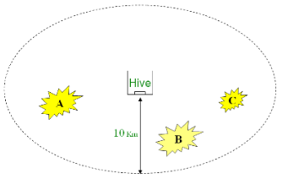
Bees in Nature
1- A colony of honey bees can extend itself over long distances in multiple directions (more than 10 km)
Masaryk University, Brno, Czech Republic , Wed 08 Apr 2009

Slide 16
Bees in Nature
Flower patches with plentiful amounts of nectar or pollen that can be collected with less effort should be visited by more bees, whereas patches with less nectar or pollen should receive fewer bees
Masaryk University, Brno, Czech Republic , Wed 08 Apr 2009

Slide 17
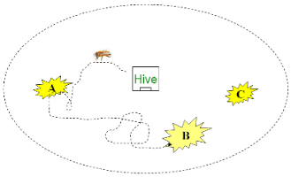
Bees in Nature
2- Scout bees search randomly from one patch to another
Masaryk University, Brno, Czech Republic , Wed 08 Apr 2009

Slide 18
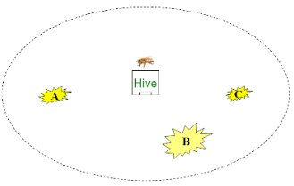
Bees in Nature
3- The bees who return to the hive, evaluate the different patches depending on certain quality threshold (measured as a combination of some elements, such as sugar content)
Masaryk University, Brno, Czech Republic , Wed 08 Apr 2009

Slide 19
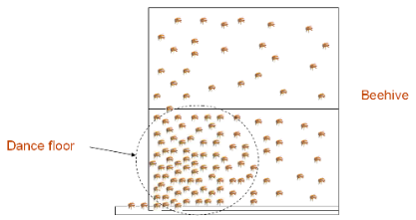
Bees in Nature
4- They deposit their nectar or pollen go to the “dance floor” to perform a “waggle dance”
Masaryk University, Brno, Czech Republic , Wed 08 Apr 2009

Slide 20
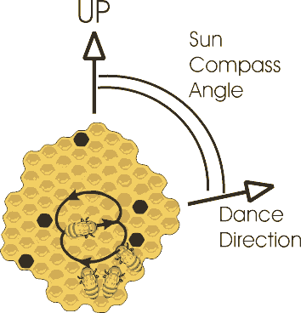
Bees in Nature
5- Bees communicate through this waggle dance which contains the following information:
    The direction of flower patches (angle between the sun and the patch)
    The distance from the hive (duration of the dance)
    The quality rating (fitness) (frequency of the dance)
Masaryk University, Brno, Czech Republic , Wed 08 Apr 2009

Slide 21
Bees in Nature
These information helps the colony to send its bees precisely
6- Follower bees go after the dancer bee to the patch to gather food efficiently and quickly
Masaryk University, Brno, Czech Republic , Wed 08 Apr 2009

Slide 22
Bees in Nature
7- The same patch will be advertised in the waggle dance again when returning to the hive is it still good enough as a food source (depending on the food level) and more bees will be recruited to that source
8- More bees visit flower patches with plentiful amounts of nectar or pollen
Masaryk University, Brno, Czech Republic , Wed 08 Apr 2009

Slide 23

Bees in Nature
Thus, according to the fitness, patches can be visited by more bees or may be abandoned
Masaryk University, Brno, Czech Republic , Wed 08 Apr 2009

Slide 24
Proposed Bees Algorithm (BA)
The Bees Algorithm is an optimisation algorithm inspired by the natural foraging behaviour of honey bees to find the optimal solution
The following figure shows the pseudo code of the algorithm in its simplest form
Masaryk University, Brno, Czech Republic , Wed 08 Apr 2009

Slide 25
Proposed Bees Algorithm (BA)
1. Initialise population with random solutions.
2. Evaluate fitness of the population.
3. While (stopping criterion not met)
//Forming new population.
4. Select sites for neighbourhood search.
5. Recruit bees for selected sites (more bees for best e sites) and evaluate fitnesses.
6. Select the fittest bee from each patch.
7. Assign remaining bees to search randomly
and evaluate their fitnesses.
8. End While.
Pseudo code of the basic bees algorithm
Masaryk University, Brno, Czech Republic , Wed 08 Apr 2009

Slide 26
Proposed Bees Algorithm (BA)
The algorithm requires a number of parameters to be set:
  Number of scout bees n
  Number of sites selected m out of n visited sites
  Number of best sites e out of m selected sites
  Number of bees recruited for best e sites nep or (n2)
  Number of bees recruited for the other (m-e) selected sites which is nsp or (n1)
  Initial size of patches ngh which includes site and its neighbourhood and stopping criterion
  Number of algorithm steps repetitions imax
100
10
3
40 in neighborhood area
Rich
Poor
20
0-1 (0.2)
10,300,1000
Masaryk University, Brno, Czech Republic , Wed 08 Apr 2009

Slide 27
Proposed Bees Algorithm (BA)
The following figure shows the flowchart of the Basic Bees Algorithm
Masaryk University, Brno, Czech Republic , Wed 08 Apr 2009

Slide 28
Initialise a Population of n Scout Bees
Evaluate the Fitness of the Population
Select m Sites for Neighbourhood Search
Determine the Size of Neighbourhood
(Patch Size ngh)
Neighbourhood Search
Recruit Bees for Selected Sites
(more Bees for the Best e Sites)
Select the Fittest Bee from Each Site
Assign the (n–m) Remaining Bees to Random Search
New Population of Scout Bees
  Flowchart of the Basic BA
Masaryk University, Brno, Czech Republic , Wed 08 Apr 2009

Slide 29
Proposed Bees Algorithm (BA)
The following is a description of the algorithm steps
1- The algorithm starts with the n scout bees being placed randomly in the search space.
  (for example n=100)
Masaryk University, Brno, Czech Republic , Wed 08 Apr 2009

Slide 30
Proposed Bees Algorithm (BA)
2- The fitnesses of the sites visited by the scout bees after return are evaluated in step 2 as follow:
  The first scout bee is taken and trained with the data. (for example: if we get 200 correct answer out of 1000 record, the bee will give the evolution of 20%)
  The second scout bee is taken and the same process is repeated and we my get 50%
  The processes will be repeated on the all scout bees and evaluated through evaluation function known as Fitness, which changes upon the studied problem
Masaryk University, Brno, Czech Republic , Wed 08 Apr 2009

Slide 31
Proposed Bees Algorithm (BA)
  The evaluation of the 100 scout bees is stored in array as follow:
  Then the array will be reordered based on the evaluation from the higher to the lower value
1 | 2 | 3 | 4 | 5 | 6 | … | … | ... | 99 | 100
20% | 50% | 60% | 30% | 80% | 10% | … | … | … | 35% | 72%
Masaryk University, Brno, Czech Republic , Wed 08 Apr 2009

Slide 32
Proposed Bees Algorithm (BA)
3- The m sites will be selected randomly (the best evaluation to m scout bee) from n
  For example m=10
  Then we choose the best e site (scout bee) out off m which is determined randomly
  For example e=2, then m-e =10-2=8
1 | 2 | 3 | 4 | 5 | 6 | 7 | 8 | 9 | 10
80% | 78% | 75% | 72% | 69% | 66% | 65% | 60% | 59% | 58%
Masaryk University, Brno, Czech Republic , Wed 08 Apr 2009

Slide 33
Proposed Bees Algorithm (BA)
4- A neighborhood search sites of size ngh is selected
Thus in this step a neighborhood size ngh is determined which will be used to update the m bees declared in the previous step
This is important as there might be better solutions than the original solution in the neighborhood area
  Suppose ngh=0.5
Masaryk University, Brno, Czech Republic , Wed 08 Apr 2009

Slide 34
Proposed Bees Algorithm (BA)
5- Recruit Bees for the selected sites and evaluate the fitness of the sites
  Number of bees (n2) will be selected randomly to be sent to e sites (n2=40)
  and choosing n1 bees randomly which their number is less than n2, (n1=20) to be sent to m-e sites
Masaryk University, Brno, Czech Republic , Wed 08 Apr 2009

Slide 35
Proposed Bees Algorithm (BA)
6- Choosing the best bee from each site (the highest fitness) to form the next bee population
  This is not exist in nature, it has been placed in the algorithm to reduce the number of sites to be explored
Masaryk University, Brno, Czech Republic , Wed 08 Apr 2009

Slide 36
Proposed Bees Algorithm (BA)
The best bee from each site of m sites is selected as follow:
  The first site will be taken (for example a site from e sites)
  An array contains n2=40 bees will be constructed, where the value of each bee is equal to the value of the original scout bee with a little modification depending on the neighborhood ngh
Masaryk University, Brno, Czech Republic , Wed 08 Apr 2009

Slide 37
Proposed Bees Algorithm (BA)
  The data will be trained on the 40 bees and evaluated through the fitness function.
  The results will be stored in temporary array.
  The array will be ordered and the best value will be taken
1 | 2 | 3 | … | 40
82% | 81.2% | 79.9% | … | 79.2%
Masaryk University, Brno, Czech Republic , Wed 08 Apr 2009

Slide 38
Proposed Bees Algorithm (BA)
  The step 6 is repeated for all m sites.
  At the end we will get the best m=10 bees which will be stored at the beginning of the array (n=100)
1 | 2 | 3 | 4 | 5 | 6 | … | 10 | 11 | … | 99 | 100
82% | 79% | 77% | 73% | 70% | 67% | … | 58.2%
Masaryk University, Brno, Czech Republic , Wed 08 Apr 2009

Slide 39
Proposed Bees Algorithm (BA)
Searches in the neighborhood of the best e sites which represent more promising solutions are made more detailed by recruiting more bees to follow them than the other selected bees.
Together with scouting, this differential recruitment is a key operation of the Bees Algorithm
Masaryk University, Brno, Czech Republic , Wed 08 Apr 2009

Slide 40
Proposed Bees Algorithm (BA)
7- Initials new population:
The remaining bees in the population will be assigned randomly around the search space (values from 11 to 100 in the previous array)
The new population becomes as follow:
1 | 2 | 3 | 4 | 5 | 6 | … | 10 | 11 | … | 99 | 100
82% | 79% | 77% | 73% | 70% | 67% | … | 58.2% | Random values
Masaryk University, Brno, Czech Republic , Wed 08 Apr 2009

Slide 41
Proposed Bees Algorithm (BA)
8- The loop counter is reduced and the steps two to seven are repeated until the stopping criterion is met. (ending the number of the repetitions imax)
  For example imax=1000
Masaryk University, Brno, Czech Republic , Wed 08 Apr 2009

Slide 42
Proposed Bees Algorithm (BA)
At the end of each iteration, the colony will have two parts to its new population representatives from each selected patch and other scout bees assigned to conduct random searches
Masaryk University, Brno, Czech Republic , Wed 08 Apr 2009

Slide 43
Simple Example: Function Optimisation
Here are a simple example about how Bees algorithm works
The example explains the use of bees algorithm to get the best value representing a mathematical function (functional optimal)
Masaryk University, Brno, Czech Republic , Wed 08 Apr 2009

Slide 44
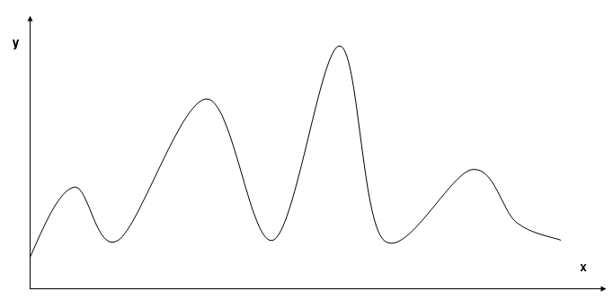
Simple Example
The following figure shows the mathematical function
Masaryk University, Brno, Czech Republic , Wed 08 Apr 2009

Slide 45
Simple Example
1- The first step is to initiate the population with any 10 scout bees with random search and evaluate the fitness. (n=10)
Masaryk University, Brno, Czech Republic , Wed 08 Apr 2009

Slide 46
Simple Example
y
*
*
*
*
*
*
*
*
*
*
x
Graph 1. Initialise a Population of (n=10) Scout Bees
with random Search and evaluate the fitness.
Masaryk University, Brno, Czech Republic , Wed 08 Apr 2009

Slide 47
Simple Example
2- Population evaluation fitness:
an array of 10 values in constructed and ordered in ascending way from the highest value of y to the lowest value of y depending on the previous mathematical function
Masaryk University, Brno, Czech Republic , Wed 08 Apr 2009

Slide 48
Simple Example
3- The best m site is chosen randomly ( the best evaluation to m scout bee) from n
  m=5, e=2, m-e=3
Masaryk University, Brno, Czech Republic , Wed 08 Apr 2009

Slide 49
Simple Example
y
▪
▪
e
m
▫
▫
▫
*
*
*
*
*
x
Graph 2. Select best (m=5) Sites for Neighbourhood Search:
(e=2) elite bees “▪” and (m-e=3) other selected bees“▫”
Masaryk University, Brno, Czech Republic , Wed 08 Apr 2009

Slide 50
Simple Example
4- Select a neighborhood search site upon ngh size:
  Assign random neighborhood ngh as follow
Masaryk University, Brno, Czech Republic , Wed 08 Apr 2009

Slide 51
Simple Example
y
▪
▪
▫
▫
▫
x
Graph 3. Determine the Size of Neighbourhood (Patch Size ngh)
Masaryk University, Brno, Czech Republic , Wed 08 Apr 2009

Slide 52
Simple Example
5- recruits more bees to the selected sites and evaluate the fitness to the sites:
  Sending bees to e sites (rich sites) and m-e sites (poor sites).
  More bees will be sent to the e site.
    n2 = 4 (rich)
    n1 = 2 (poor)
Masaryk University, Brno, Czech Republic , Wed 08 Apr 2009

Slide 53
Simple Example
* *
* *
y
* *
*
▪
*
*
*
▪
*
*
*
▫
*
*
*
▫
*
▫
*
*
*
x
Graph 4. Recruit Bees for Selected Sites
(more Bees for the e=2 Elite Sites)
Masaryk University, Brno, Czech Republic , Wed 08 Apr 2009

Slide 54
Simple Example
6- Select the best bee from each location (higher fitness) to form the new bees population.
  Choosing the best bee from every m site as follow:
Masaryk University, Brno, Czech Republic , Wed 08 Apr 2009

Slide 55
Simple Example
y
*
▪
*
*
*
▪
*
*
*
▫
*
*
*
▫
*
▫
*
*
*
x
Graph 5. Select the Fittest Bee * from Each Site
Masaryk University, Brno, Czech Republic , Wed 08 Apr 2009

Slide 56
Simple Example
7- initializes a new population:
  Taking the old values (5) and assigning random values (5) to the remaining values n-m
Masaryk University, Brno, Czech Republic , Wed 08 Apr 2009

Slide 57
Simple Example
y
e
*
o
*
*
m
o
*
o
o
*
o
x
Graph 6. Assign the (n–m) Remaining Bees to Random Search
Masaryk University, Brno, Czech Republic , Wed 08 Apr 2009

Slide 58
Simple Example
8- the loop counter will be reduced and the steps from two to seven will be repeated until reaching the stopping condition (ending the number of repetitions imax)
At the end we reach the best solution as shown in the following figure
  This best value (best bees from m) will represent the optimum answer to the mathematical function
Masaryk University, Brno, Czech Republic , Wed 08 Apr 2009

Slide 59
Simple Example
y
*
*
*
*
*
x
Graph 7. Find The Global Best point
Masaryk University, Brno, Czech Republic , Wed 08 Apr 2009

Slide 60
BA- Applications
Function Optimisation
BA for TSP
Training NN classifiers like MLP, LVQ, RBF and SNNs
  Control Chart Pattern Recognitions
  Wood Defect Classification
  ECG Classification
Electronic Design
Masaryk University, Brno, Czech Republic , Wed 08 Apr 2009

Slide 61
BA- Applications
Mechanical designs like:
  Design of welded beam
  Design of coil spring
Digital Filter Optimisation
Fuzzy Control Design
Data Clustering (solving the local optimum for K-means algorithm)
Robot control
Masaryk University, Brno, Czech Republic , Wed 08 Apr 2009

Slide 62
Data Mining Rules Pruning Using BA
The aim of the research is to develop a good learning algorithm able to generate a good set of rules
  RULES-5 Inductive Learning algorithm has been used for extracting if-then classification rules from set of examples have continuous and discrete attributes
Masaryk University, Brno, Czech Republic , Wed 08 Apr 2009

Slide 63
Data Clustering Using BA
K-means clustering is one of the most popular clustering methods because of its simplicity and computational efficiency. K-means clustering involves search and optimization
The main problem with this clustering method is its tendency to converge to local optima
A work has been done by integrating the simplicity of the k-means algorithm with the capability of the Bees Algorithm to avoid local optima
Masaryk University, Brno, Czech Republic , Wed 08 Apr 2009

Slide 64
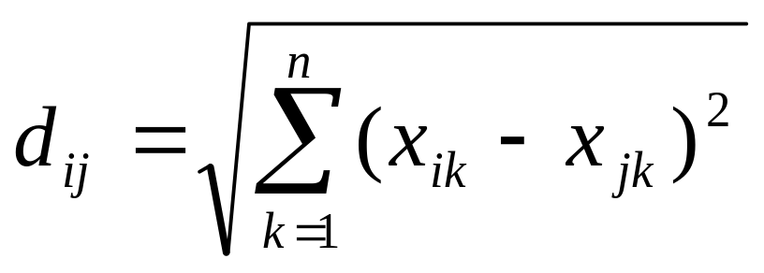
Data Clustering Using BA
Briefly, the job of the BA is to search for suitable centres of the clusters (c1, c2,…,ck) which makes the Euclidian distance d_{ij} as lower as possible
Masaryk University, Brno, Czech Republic , Wed 08 Apr 2009

Slide 65
Optimising NNs for Identification of Wood Defects Using the BA
An application of the Bees Algorithm to the optimisation of neural networks for the identification of defects in wood veneer sheets
Authors claimed that the accuracy obtained is comparable to that achieved using backpropagation
However, the Bees Algorithm proved to be considerably faster
Masaryk University, Brno, Czech Republic , Wed 08 Apr 2009

Slide 66
Application of the BA to Fuzzy Clustering
A work has been done on combining the Bees Algorithm with the FCM algorithm which improved the fuzzy clustering results compared to the traditional C-means algorithm in most cases
They also proved that the Bees Algorithms produces better results than those of the GA combined with FCM
Masaryk University, Brno, Czech Republic , Wed 08 Apr 2009

Slide 67
BA pros and cons
The advantages of the BA
  Very efficient in finding optimal solutions
  Overcoming the problem of local optima
The disadvantages of the BA
  It is using a number of tunable parameters
  The parameters values could be set by conducting a small number of trails
Masaryk University, Brno, Czech Republic , Wed 08 Apr 2009

Slide 68
Conclusion
A new optimisation algorithm has been presented
Authors claimed that the algorithm has remarkable robustness, producing 100% success rate in all cases they have tackled
The algorithm outperformed other techniques in terms of speed of optimisation and accuracy of the obtained results
Masaryk University, Brno, Czech Republic , Wed 08 Apr 2009
Notes:
This paper has described the use of the Bees Algorithm to train the LVQ neural network for control chart pattern recognition. Despite the high dimensionality of the problem – each bee represented 2160 parameters that had to be determined – the algorithm still succeeded to train more accurate classifiers than that produced by the standard LVQ training algorithm. Future work will be directed at investigating classifiers based on other neural network paradigms and comparing their performances.

Slide 69
BA Web Site (Cardiff University, UK)
http://www.bees-algorithm.com/
Masaryk University, Brno, Czech Republic , Wed 08 Apr 2009
Notes:
This paper has described the use of the Bees Algorithm to train the LVQ neural network for control chart pattern recognition. Despite the high dimensionality of the problem – each bee represented 2160 parameters that had to be determined – the algorithm still succeeded to train more accurate classifiers than that produced by the standard LVQ training algorithm. Future work will be directed at investigating classifiers based on other neural network paradigms and comparing their performances.

Slide 70
Acknowledgment
Thanks to the Erasmus windows3 Consortium, especially the Lund University team, Sweden (the main coordinator of the project) who gave me the chance to participate in this project
Thanks to the host university, Masaryk University team, especially Dr. Lubomir Poplinsky from IF, and Mrs Amal Al-Khatib from the international office who made the life easy for me in Brno
Masaryk University, Brno, Czech Republic , Wed 08 Apr 2009

Slide 71
References
Salem Z. Ades N and Hilali E. RULES-5 Algorithm Enhancement by Using Bees Algorithm, Res. J. of Aleppo Univ. Engineering Science Series No.66. 2009
Pham DT, Ghanbarzadeh A, Koc E, Otri S, Rahim S and Zaidi M. The Bees Algorithm. Technical Note, Manufacturing Engineering Centre, Cardiff University, UK, 2005
Pham DT, Afify A, Koc A. "Manufacturing cell formation using the Bees Algorithm". IPROMS 2007 Innovative Production Machines and Systems Virtual Conference, Cardiff, UK.
Pham DT, Koc E, Lee JY, and Phrueksanant J. Using the Bees Algorithm to schedule jobs for a machine, Proc Eighth International Conference on Laser Metrology, CMM and Machine Tool Performance, LAMDAMAP, Euspen, UK, Cardiff, p. 430-439, 2007.
Pham D.T., Ghanbarzadeh A., Koc E., Otri S., Rahim S., and M.Zaidi. "The Bees Algorithm - A Novel Tool for Complex Optimisation Problems"", Proceedings of IPROMS 2006 Conference, pp.454-461
Pham DT, Soroka AJ, Ghanbarzadeh A, Koc E, Otri S, and Packianather M. Optimising neural networks for identification of wood defects using the Bees Algorithm, Proc 2006 IEEE International Conference on Industrial Informatics, Singapore, 2006.
Masaryk University, Brno, Czech Republic , Wed 08 Apr 2009

Slide 72
References
Pham DT, Darwish AH, Eldukhri EE, Otri S. "Using the Bees Algorithm to tune a fuzzy logic controller for a robot gymnast."", Proceedings of IPROMS 2007 Conference
Pham DT, Otri S, Afify A, Mahmuddin M, and Al-Jabbouli H. Data clustering using the Bees Algorithm, Proc 40th CIRP Int. Manufacturing Systems Seminar, Liverpool, 2007.
Pham DT, Ghanbarzadeh A. "Multi-Objective Optimisation using the Bees Algorithm"", Proceedings of IPROMS 2007 Conference
Pham DT, Muhamad Z, Mahmuddin M, Ghanbarzadeh A, Koc E, Otri S. Using the bees algorithm to optimise a support vector machine for wood defect classification. IPROMS 2007 Innovative Production Machines and Systems Virtual Conference, Cardiff, UK.
Pham DT, Koc E, Ghanbarzadeh A, and Otri S. Optimisation of the weights of multi-layered perceptrons using the Bees Algorithm, Proc 5th International Symposium on Intelligent Manufacturing Systems, Turkey, 2006.
Pham DT, Soroka AJ, Koc E, Ghanbarzadeh A, and Otri S. Some applications of the Bees Algorithm in engineering design and manufacture, Proc Int. Conference on Manufacturing Automation (ICMA 2007), Singapore, 2007.
Masaryk University, Brno, Czech Republic , Wed 08 Apr 2009

Slide 73
References
Pham DT, Ghanbarzadeh A, Koc E, and Otri S. Application of the Bees Algorithm to the training of radial basis function networks for control chart pattern recognition, Proc 5th CIRP International Seminar on Intelligent Computation in Manufacturing Engineering (CIRP ICME '06), Ischia, Italy, 2006.
Pham DT, Otri S, Ghanbarzadeh A, and Koc E. Application of the Bees Algorithm to the training of learning vector quantisation networks for control chart pattern recognition, Proc Information and Communication Technologies (ICTTA'06), Syria, p. 1624-1629, 2006.
Pham DT, Castellani M, and Ghanbarzadeh A. Preliminary design using the Bees Algorithm, Proc Eighth International Conference on Laser Metrology, CMM and Machine Tool Performance, LAMDAMAP, Euspen, UK, Cardiff, p. 420-429, 2007.
Masaryk University, Brno, Czech Republic , Wed 08 Apr 2009

Slide 74
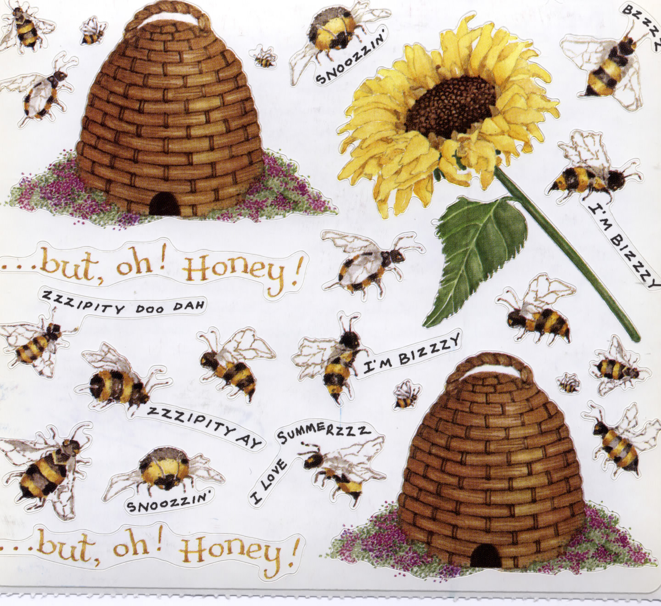
References
Thanks for your attention
Masaryk University, Brno, Czech Republic , Wed 08 Apr 2009

